Slide 1
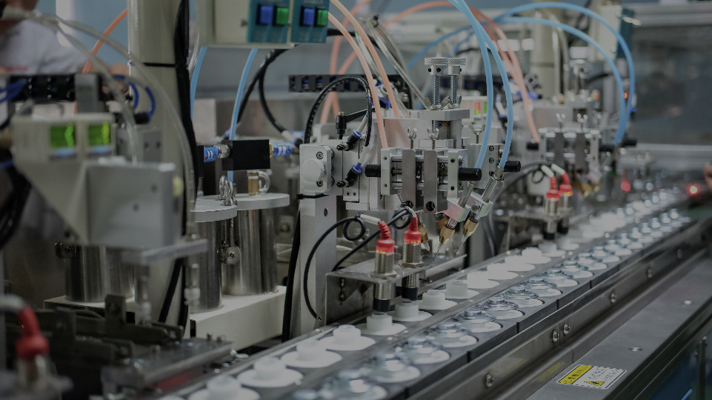
FST SPEAKERS
Company Profile 公司簡介
富声达

Slide 2







Our History 我們的歷史
Third Manufacturing Plant 新工廠
Expanded to Sungai Petani, Malaysia
馬來西亞雙溪大年新工廠成立
NEW
Setting up Voice Coil Production line in Malaysia factory
在馬來西亞工廠成立音圈生產線
First Manufacturing Plant
工廠遷移
From Taiwan to Ningbo, China
從臺灣遷移至中國寧波
Founded 成立
New sales offices 新辦事處
Kaohsiung, Taiwan
臺灣高雄
Toronto, Canada and Penang, Malaysia
加拿大多伦多和馬來西亞槟城
1970
1997
2018
Fusungta © 2026 Fusungta
1966
1993
2001
2023
2026
Oct
Technology JV
技術合資
Second Manufacturing Plant
新工廠
Production line expansion
生產線擴建
Dongguan, China 中國東莞
Ningbo, China 中國寧波
Foster Japan
日本丰达
Strictly for internal viewing only. Do not circulate without written consent from Fusungta.

Slide 3
Our Locations 我們的位置
1
CHN Hong Kong Headquarter
中國香港總部
2
CHN Ningbo Manufacturing Plant
中國寧波工廠
3
CHN Dongguan Manufacturing Plant
中國東莞工廠
4
MYS Sungai Petani Manufacturing Plant
馬來西亞雙溪大年工廠
5
Taiwan Taipei Sales Office
中國台灣臺北辦公室
6
Taiwan Kaohsiung Sales Office
中國台灣高雄辦公室
7
Canada Sales Office
加拿大辦公室
7
2
NEW
5 & 6
Fusungta © 2026 Fusungta
3
1
4
Strictly for internal viewing only. Do not circulate without written consent from Fusungta.

Slide 4
Organization Chart 組織圖表
Carlos Chen 陳家隆
Chairman 董事長
Jimmy Liu 劉駿民
Vice President (Sales)
副總經理 （營業)
Dongguan 東莞
Colin Hsu 許海城
Vice President (Engineering)
副總經理 （技術）
Ningbo 寧波
Will Chang 張勝卿
Vice President (Production)
副總經理 （生產）
Dongguan 東莞
TY Loo 盧德儀
Vice President
副總經理
Sungai Petani 雙溪大年
Fusungta © 2026 Fusungta
Strictly for internal viewing only. Do not circulate without written consent from Fusungta.

Slide 5
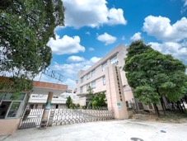
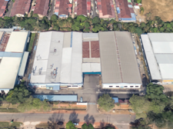
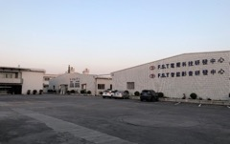
Our factories
Fusungta (Hong Kong) Company Limited
Ningbo Fusungta Electrical
Co., Ltd.
Fusungta (Dongguan) Electrical Machinery Co., Ltd.
Fusungta Technologies Sdn. Bhd.
100% owned
Fusungta © 2026 Fusungta
Ningbo, China
Dongguan, China
Sungai Petani, Malaysia
Strictly for internal viewing only. Do not circulate without written consent from Fusungta.

Slide 6
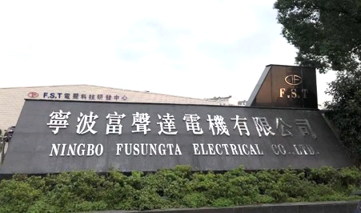
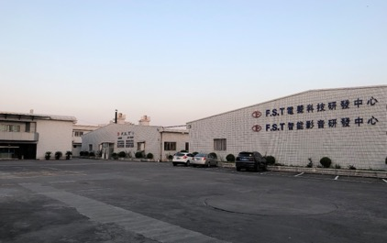
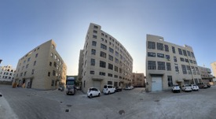
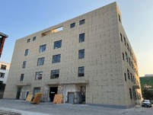
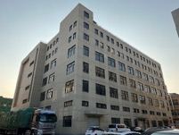
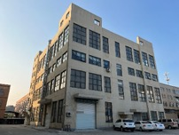
FST Ningbo, China Plant 寧波富聲達工廠
Fusungta © 2026 Fusungta
Strictly for internal viewing only. Do not circulate without written consent from Fusungta.

Slide 7

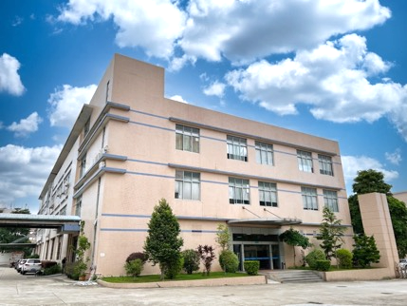
FST Dongguan, China Plant 東莞富聲達工廠
Fusungta © 2026 Fusungta
Strictly for internal viewing only. Do not circulate without written consent from Fusungta.

Slide 8
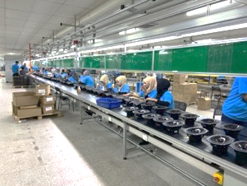
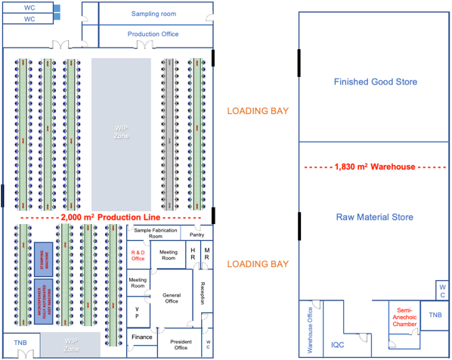
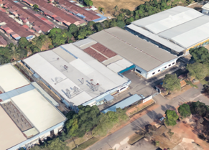
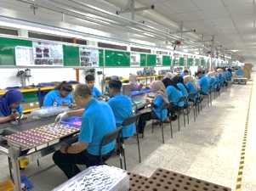
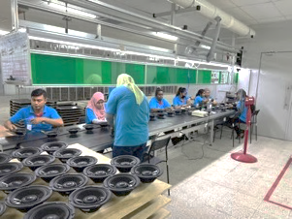
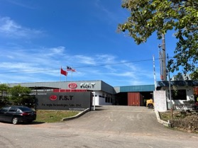
Malaysia Factory Layout
Fusungta © 2026 Fusungta
Location | : | Sungai Petani City, Kedah State, Malaysia
Build-up area | : | 62,480 sqft (5,804 sqm)
Production line | : | 8 assembly lines
Workforce | : | > 130 pax
Annual output | : | 1.8 mil pcs (micro-speakers) + 720k pcs (Automotive speakers)
Certifications | : | ISO9001, IATF16949
Products | : | Automotive, marines, ceiling-/wall-mount and micro-speakers
Strictly for internal viewing only. Do not circulate without written consent from Fusungta.

Slide 9
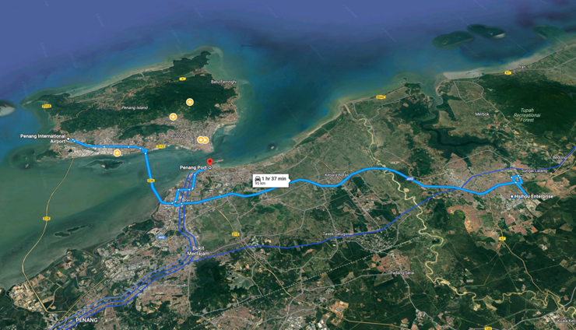
FST Sungai Petani, Malaysia Plant 富聲達馬來西亞雙溪大年工廠
Strategic location
Penang International Airport
Fusungta © 2026 Fusungta
Penang Port
Fusungta
High speed train
Strictly for internal viewing only. Do not circulate without written consent from Fusungta.

Slide 10
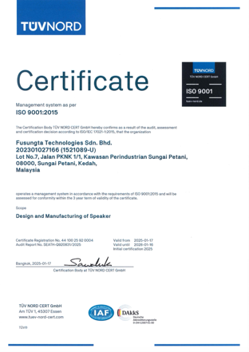
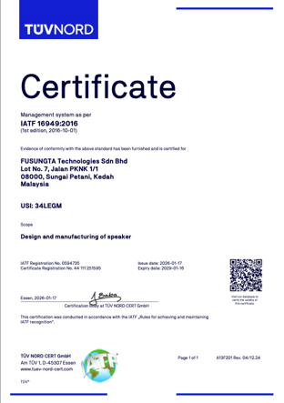
FST Malaysia - ISO9001:2015 and IATF 16949:2016 Certificate
Fusungta © 2026 Fusungta
Strictly for internal viewing only. Do not circulate without written consent from Fusungta.

Slide 11
Malaysia factory timeline
Legal Structure and Registration
Components Fabrications
Company incorporated on 17th July
Fully owned by Fusungta (Hong Kong) Co., Ltd.
Setting up Voice Coil Production line
First 40HQ to Ohio
Automotive speakers
Certified
Trial run
ISO 9001
IATF 16949
Recruited 30 production operators
Total 4 assembly lines
Aug - Nov 2023
Feb
2024
June
2024
Nov
2024
Fusungta © 2026 Fusungta
July 2023
Dec 2023
March
2024
Jan
2025
Oct
2026
Mass production
Expansion
Automotive speakers
Added 4 conveyor lines
Setting up
Secured factory in Sungai Petani
Manufacturing & Business license application
LMW application (Import/export customs duty exemption)
Environment and Fire risk safety assessment
Safety, health and environment assessment
Line supervisor recruitment & training
Import and local sourcing of Machine/Equipment/Fixtures/Materials
Shipment
Achieve 3 x 40HQ shipment per month
Strictly for internal viewing only. Do not circulate without written consent from Fusungta.

Slide 12
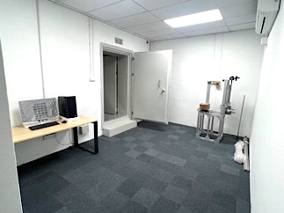
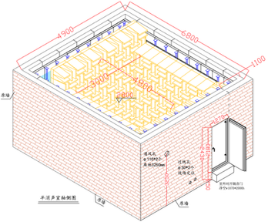
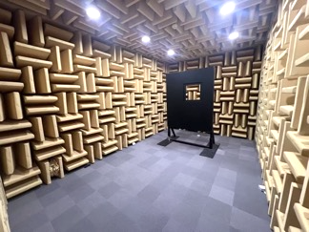
Semi-Anechoic Chamber
Construction of semi-anechoic chamber completed in January 2025
Ambient Noise: ≤25dB(A)
Sound insulation capacity: Lp≥50
Cut-off frequency: 125Hz
Fusungta © 2026 Fusungta
Designed accordance to:
ISO3745 (Acoustics–Determination of sound power levels of noise)
ISO7779 (Equipment sound measuring standard )
GB/T6882 (Acoustics: Determination of sound power of noise source)
Strictly for internal viewing only. Do not circulate without written consent from Fusungta.

Slide 13























Products
產品
Automotive Speakers
汽車喇叭
Subwoofers
低音炮
Marine Speakers
船用喇叭
Wall/Ceiling Speakers
嵌牆/吸頂喇叭
Fusungta © 2026 Fusungta
PA Speakers
PA 喇叭
Home Audio
家庭音響
Bluetooth Speakers
蓝牙音箱
Motorcycle Audio
摩托车音響
ATV Mobile Speakers
越野车
Golf Cart
高尔夫球车
Motorcycle Speakers
摩托车喇叭
Micro-speakers
微型喇叭
Strictly for internal viewing only. Do not circulate without written consent from Fusungta.

Slide 14
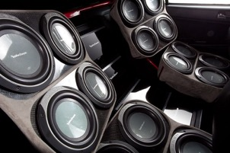
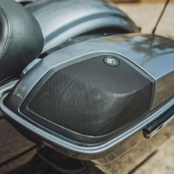
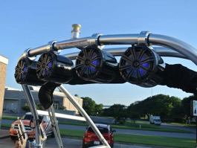
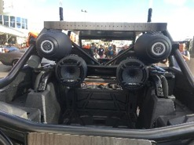
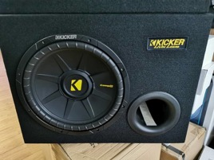
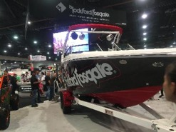
Products Usage
產品應用
Fusungta © 2026 Fusungta
Strictly for internal viewing only. Do not circulate without written consent from Fusungta.

Slide 15
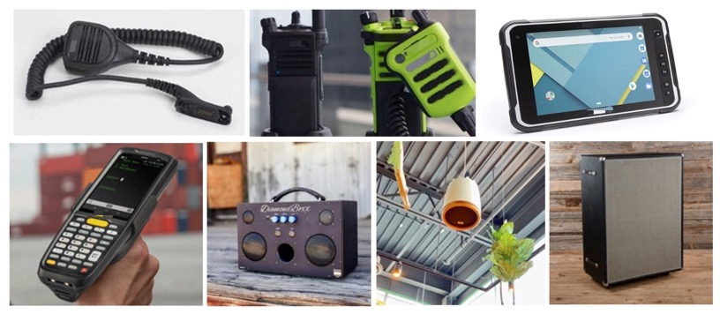
Products Usage
產品應用
Fusungta © 2026 Fusungta
Strictly for internal viewing only. Do not circulate without written consent from Fusungta.

Slide 16
New Product Development Procedures
新產品開發流程
ID
Product definition 產品定義
Run first prototype (Off-the-shelf / 3D printing / CNC machining) 執行第一個原型 (現成/3D列印/CNC加工)
EVT
Soft tooling sample 軟模樣品
Mechanical dimension and performance review 機械尺寸和性能審查
DVT
Hard tooling fabrication 硬模樣品製造
Trail run for tooling check and verification 試產確認模具
Product stability verification and power testing 產品穩定性驗證和功率測試
Environment reliability testing 環境可靠性測試
Fusungta © 2026 Fusungta
PVT
APQP, PPAP, SPC, Quality assessment 質量評估
Final confirmation on tooling and parts material 模具和零件的最終確認
MP
Release specification sheet 發行規格書
Strictly for internal viewing only. Do not circulate without written consent from Fusungta.

Slide 17
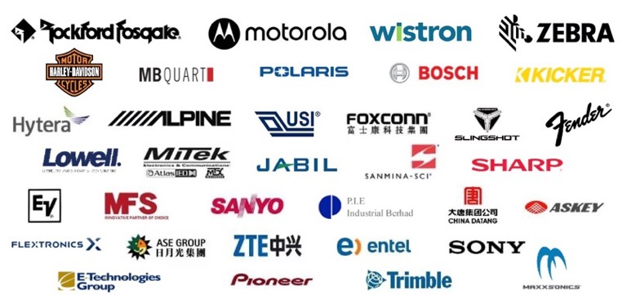
Customer base 客戶群
Fusungta © 2026 Fusungta
Strictly for internal viewing only. Do not circulate without written consent from Fusungta.

Slide 18













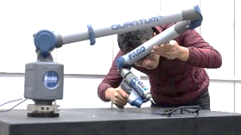
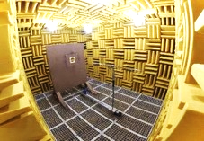
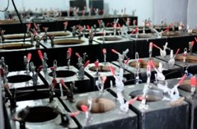
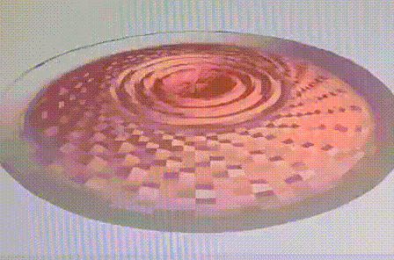
R&D capabilities 技術開發能力
FINEMotorTM
FINEConeTM
FINESuspensionTM
Fusungta © 2026 Fusungta
Quantum FaroArm
Anechoic Chamber
Power test
Klippel
Strictly for internal viewing only. Do not circulate without written consent from Fusungta.

Slide 19

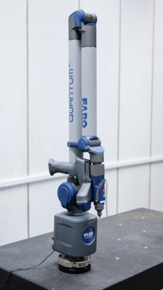
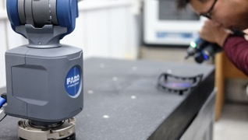
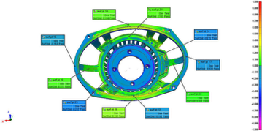
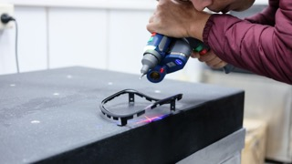
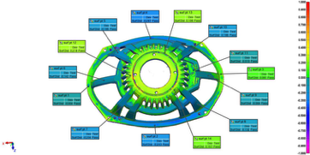
R&D capabilities 技術開發能力
Quantum FaroArm
Portable coordinate measuring machine (PCMM)
Fusungta © 2026 Fusungta
Strictly for internal viewing only. Do not circulate without written consent from Fusungta.

Slide 20



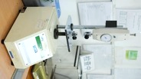
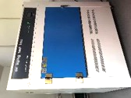
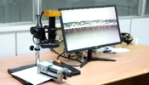


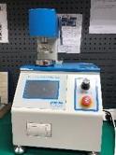



IPQC facilities 進料檢驗設備
Gauss meter
Resistance meter
VC temp. meter
Pull tester
Fusungta © 2026 Fusungta
UV aging
Digital measuring device
DC resistance meter
Microscope
Burst tester
Spider deflection tester
F0 meter
Auto burst tester
Strictly for internal viewing only. Do not circulate without written consent from Fusungta.

Slide 21
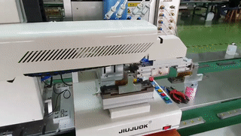
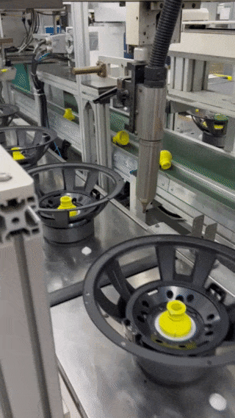
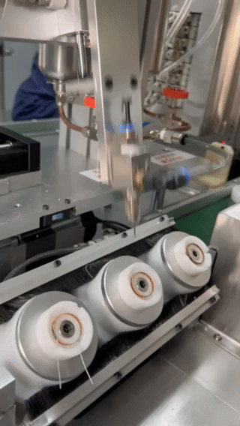
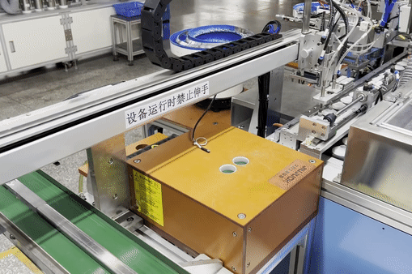
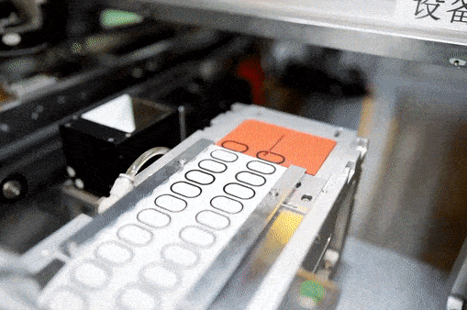
Automated Assembly Machines 自动化生产线
Diaphragm-voice coil assembly
Fusungta © 2026 Fusungta
Magnet magnetizer
Plasma treatment
Automated voice coil epoxy dispenser
Strictly for internal viewing only. Do not circulate without written consent from Fusungta.
Adhesive assembly

Slide 22
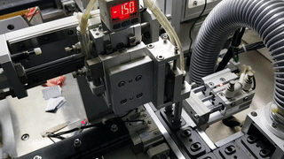




Advanced Automation Production Line
先進的自動化生產線
Automated placement of magnet on fixture
Automated magnet-frame assembly
2-way epoxy dispenser
Fusungta © 2026 Fusungta
Automated AB glue dispenser
Automated frame assembly
Automated voice coil assembly
Strictly for internal viewing only. Do not circulate without written consent from Fusungta.

Slide 23












OLQC 線上檢驗
F0 check
Polarity check
Audio sweep test
LOUD on-line inspection
Fusungta © 2026 Fusungta
Impedance check
SoundCheck
Leak test
Clio On-line inspection
Klippel QC
Soldering check
Cosmetic check
First sample buy off
Strictly for internal viewing only. Do not circulate without written consent from Fusungta.

Slide 24




Advanced Automation Production Line
先進的自動化生產線
Fusungta © 2026 Fusungta
Strictly for internal viewing only. Do not circulate without written consent from Fusungta.

Slide 25


